Slide 1
Microservices & Docker
Kubernetes Workshop – Session 1

Slide 2
Agenda
Workshop Session Breakdown
Docker Containers
Containers vs VMs
Working with Docker (Build, Ship, Run)
Container Architecture
Microservices Overview

Slide 3
Workshop Plan
Planned Outcome
At the end of the workshop, you should:
Be able to deploy and manage a full stack application in Kubernetes.
Have an understanding about the design aspects and best practices of microservices.
Session 1: Microservices and Docker
Microservices characteristics
Why Docker
Hands on: Creating a docker container
Session 2: Kubernetes Basics
Docker Hands on - continued
Understand why K8S is needed
Hands on: Deploying the container in K8S
K8S architecture (very high level)

Slide 4
Workshop Plan Continued
Session 3: Kubernetes II
Hands on: Deploying multiple containers – Services, Helm chart
Readiness and Liveness Probes
Session 4: Kubernetes III
Hands on: External configuration and data for these containers – Secrets, Config maps
Persistent storage
Session 5: Microservices design
12 factor app
Popular design patterns (sidecar, ambassador, adapter,..)
Deployment strategies, Init containers, Daemonsets
Session 6: Conclusion
Thought exercise on migrating an on-prem to microservices
Open discussion

Slide 5
Microservices

Slide 6
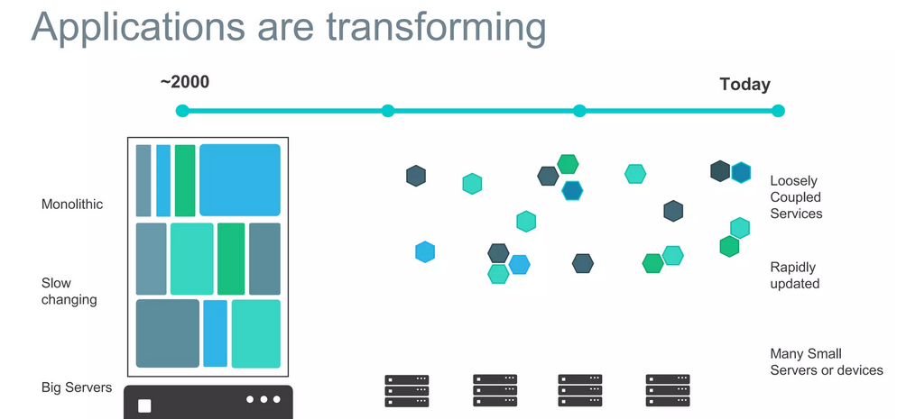

Slide 7
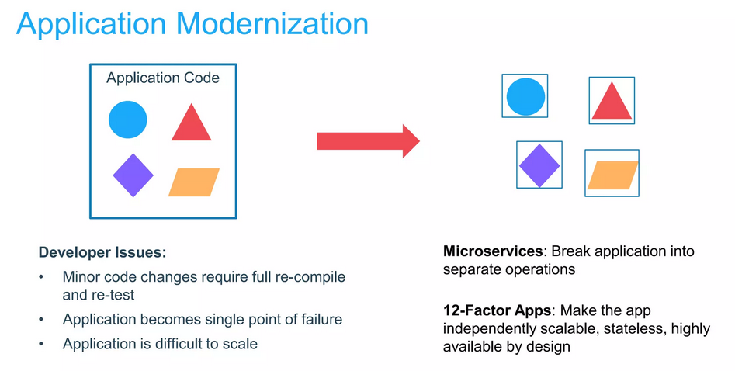

Slide 8
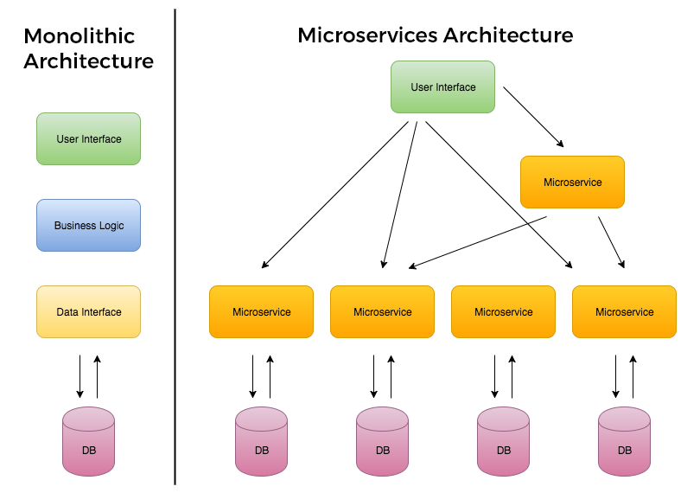

Slide 9
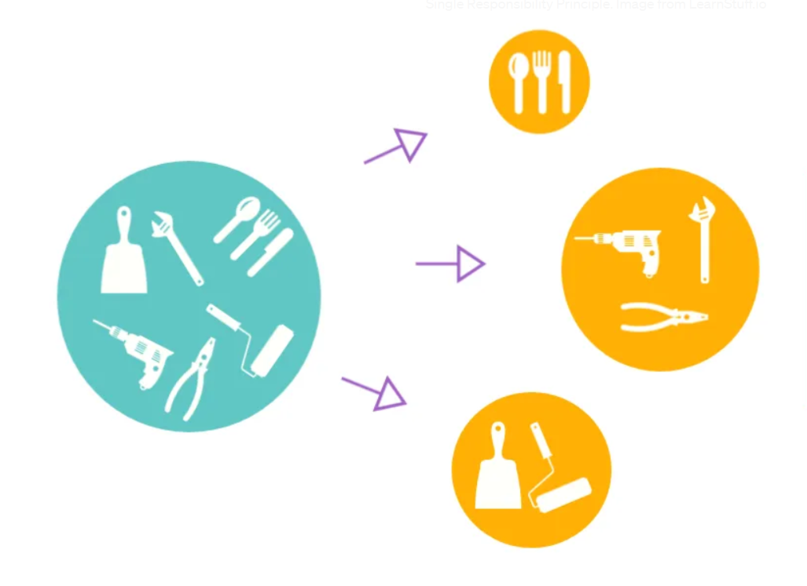
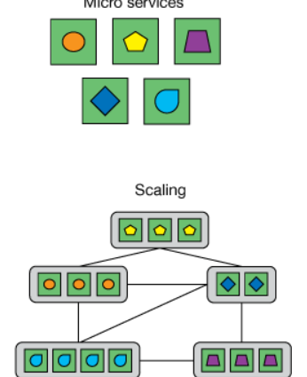

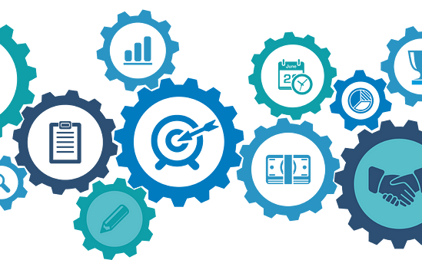
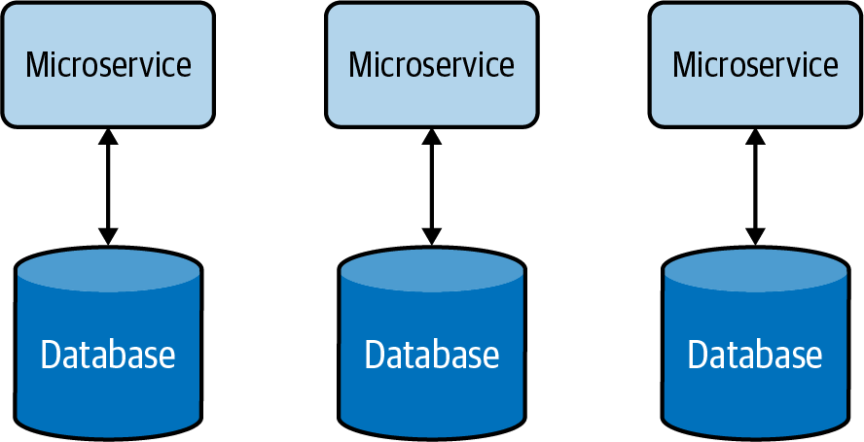
Key characteristics
Service independence
Decentralized data management
Single Responsibility Principle
Scalability
Resilience
Independently deployable.
Greater flexibility in development and scaling.
Each service can be written in a different programming language or technology stack.
Each microservice can have its own database.
Data isolation
Reduced coupling
Better data management
Each microservice has a single, well-defined responsibility.
Easier to develop, test, and maintain.
Ability to scale individual services independently.
Efficient resource utilization, cost savings, and improved performance
Promotes resilience through redundancy and fault tolerance.
If one service fails, the rest of the application can continue to function.

Slide 10
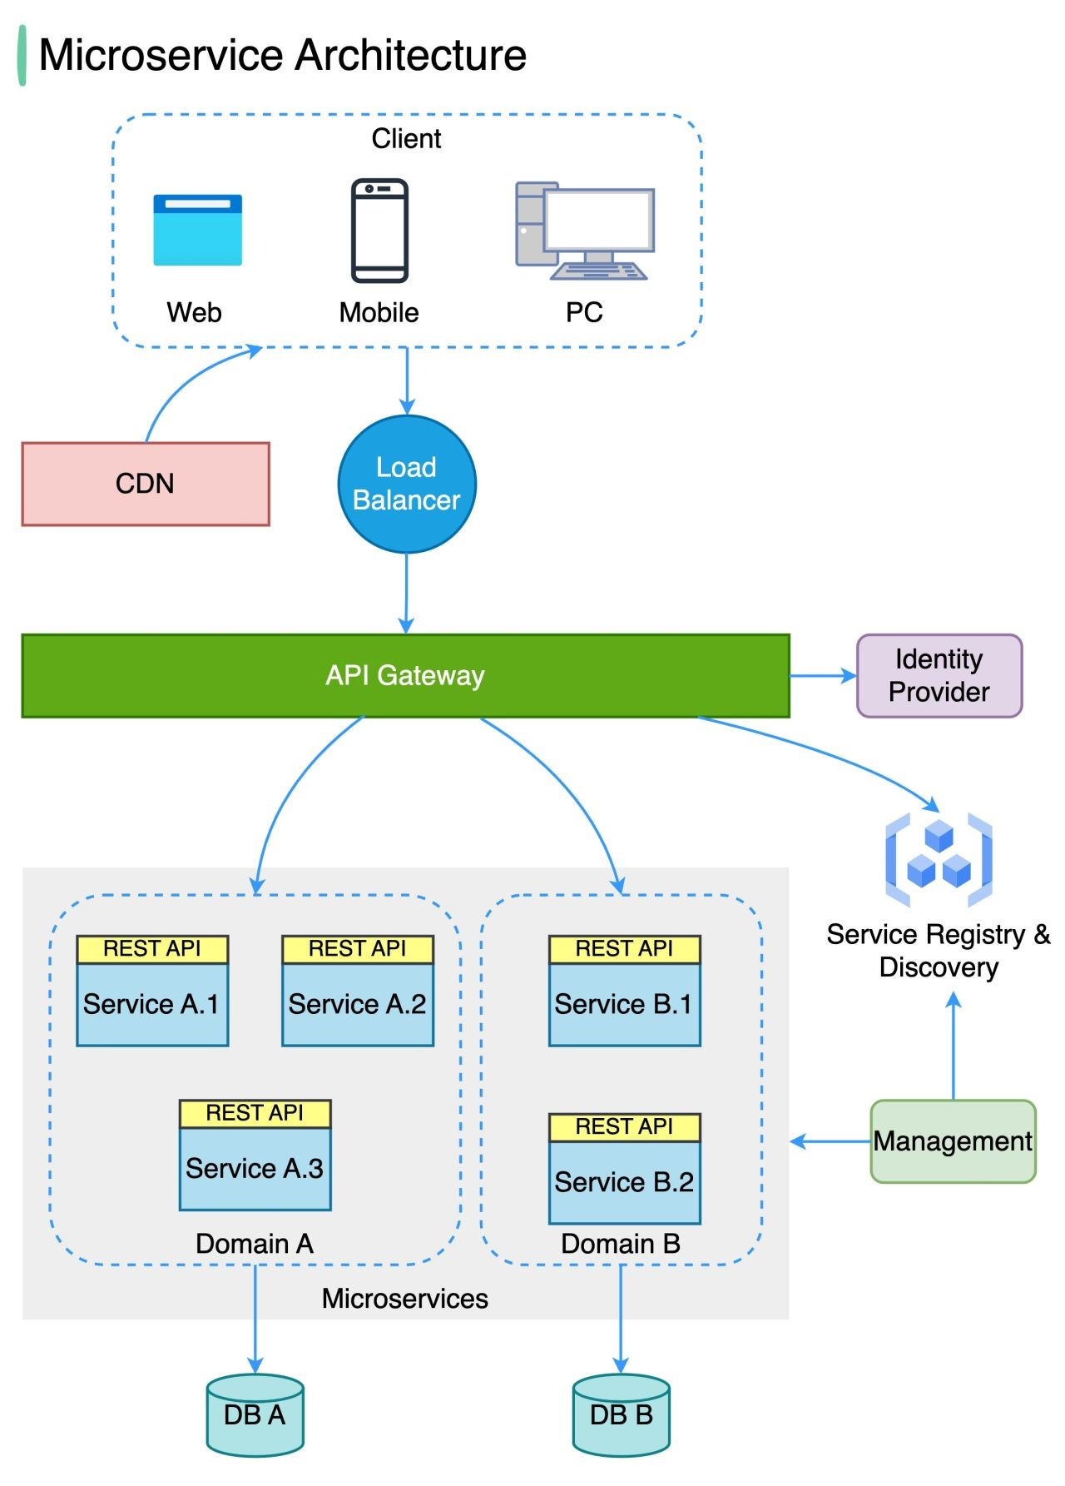

Slide 11
Containerization

Slide 12
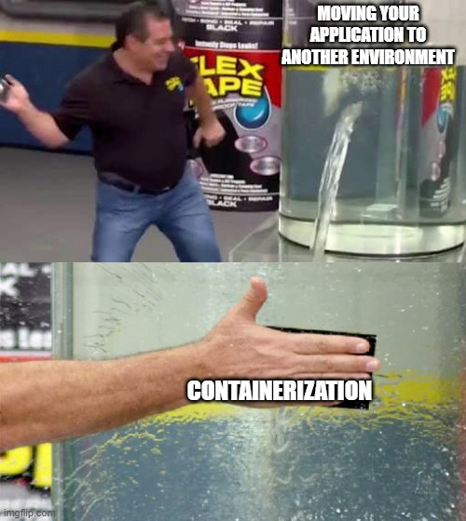
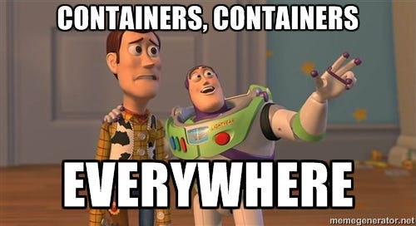
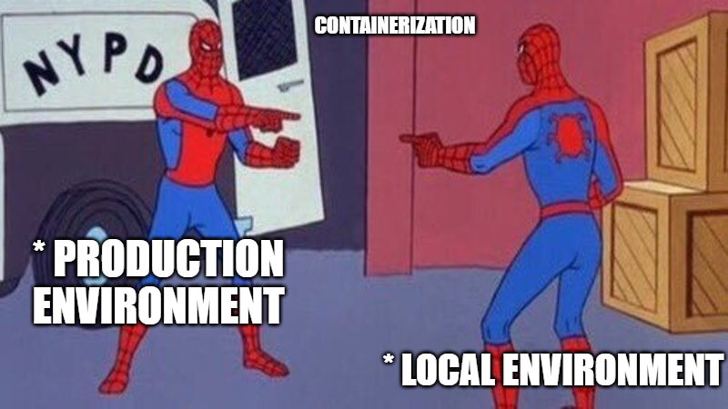

Slide 13
Docker

Slide 14
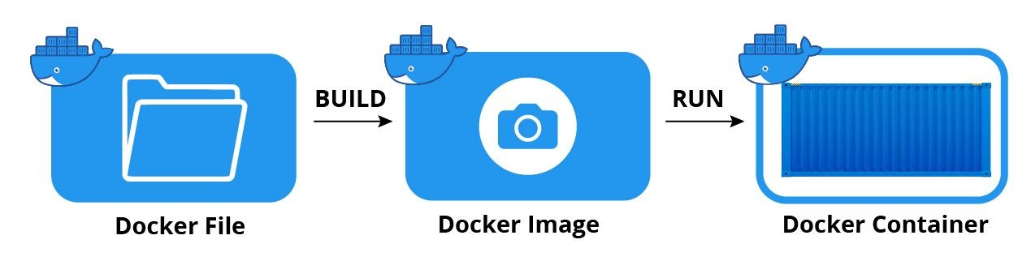
Docker
Docker is a platform that allows developers to build, ship and run applications anywhere as containers.

Slide 15
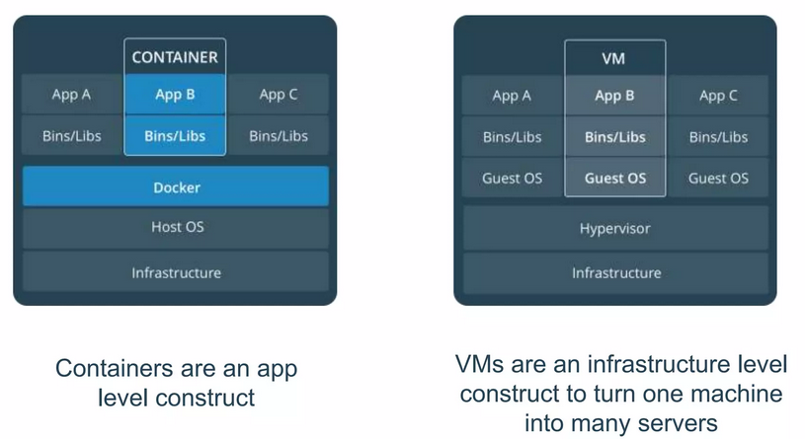
Why Docker
Docker container packages up an application with all its dependencies and runs on Docker engine.
Fast as there is no OS to boot
Lightweight
Portable - Build once, run anywhere
Secure as it has less privileges

Slide 16
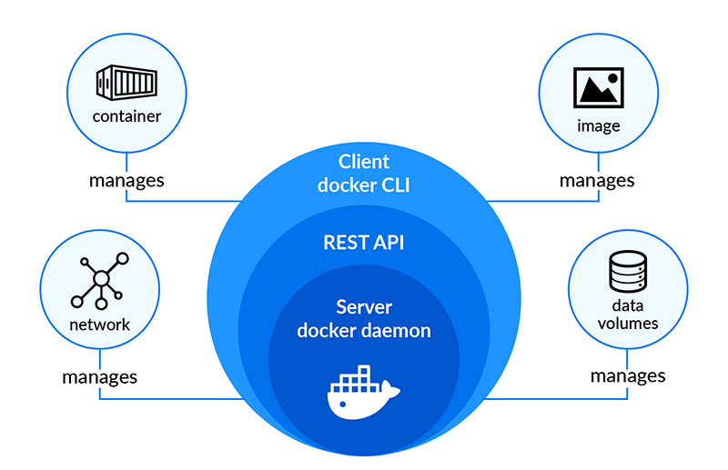
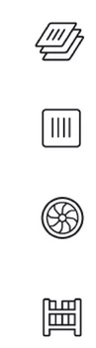
Docker Architecture
Image
Application and its dependencies configured and packaged together.
Container
Image when it is running.
Docker Engine / Daemon
Docker server that manages running containers, executes commands on them. Also manages network and volumes.
Registry
Stores and distributes docker images. DockerHub is public registry while Artifactory is out private registry.

Slide 17
Exercise 1 – Build nginx container with a static webpage
Objective:
To get used to important Docker CLI commands.
To get understanding of writing a basic Dockerfile.
To do:
Create a Dockerfile with below instructions
From nginx base image
Create and copy index.html to nginx html folder
Expose a port
Include command to start the nginx server
Build and create image - docker build -t firstContainer .
Run as container - docker run -d -p 80:80 first_container
Verify

Slide 18
Exercise 1 – Contd.
Modify the index.html
Build a new image with a new tag
Run as a container in a new port
Verify

Slide 19
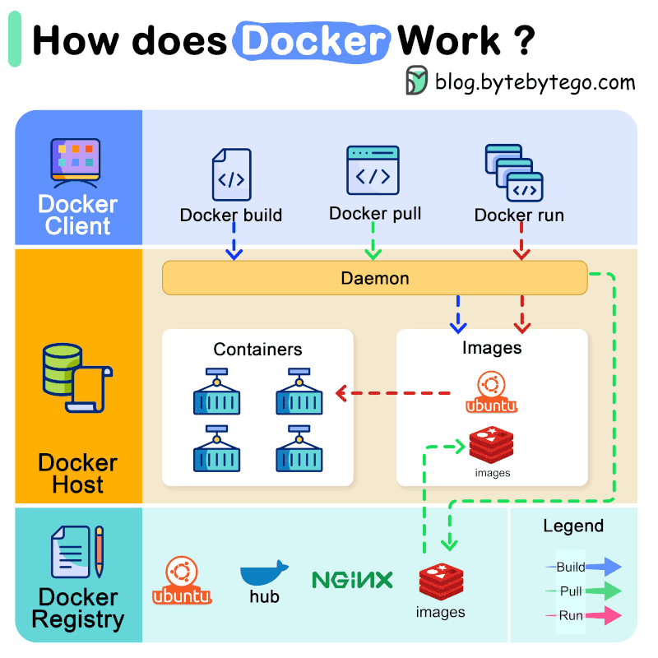

Slide 20
Traditional Installation of Java Web Application
Create an installer for that will:
Install JDK
Install tomcat
Install our application
Configure the application
Start the application
Create different installer for each supported OS
Create upgrade scripts for each OS
Create VM to deploy the application

Slide 21
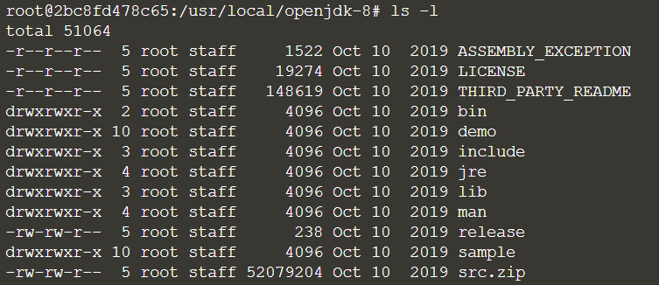
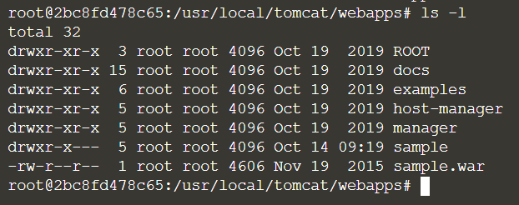
Installed Application on Disk
JDK Installation
Tomcat Installation
Create PATH and environment variables
This snapshot of deployment (some OS files + JDK files + tomcat files + application files) is packaged into a Docker image.

Slide 22
Exercise 2: Containerize a sample web app
Create a Dockerfile with below instructions
From tomcat base image
Copy the WAR to the tomcat webapps folder
Expose port
Run Command to start server
Build docker image:
docker build . -t tomcatcontainer
Run docker container:
docker container run -d --it -p 80:8080 tomcatcontainer
Access the tomcat via URL
Stop the container

Slide 23
Food for thoughts
Is microservice architecture and Docker container inter-dependent?
Do microservices require to be delivered as docker containers?
Do docker containers require that the application containerized to be a microservice?

Slide 24
Further reading
https://www.freecodecamp.org/news/microservices-architecture-for-humans/
https://docs.docker.com/get-started/02_our_app/
https://github.com/docker/getting-started-app
https://github.com/docker/labs/blob/master/beginner/readme.md
https://docs.docker.com/engine/reference/builder/
https://docs.docker.com/develop/develop-images/dockerfile_best-practices/
https://github.com/raghavendran-gopalakrishnan/K8S-Workshop

